Slide 1
Exercise employee manager

Slide 2
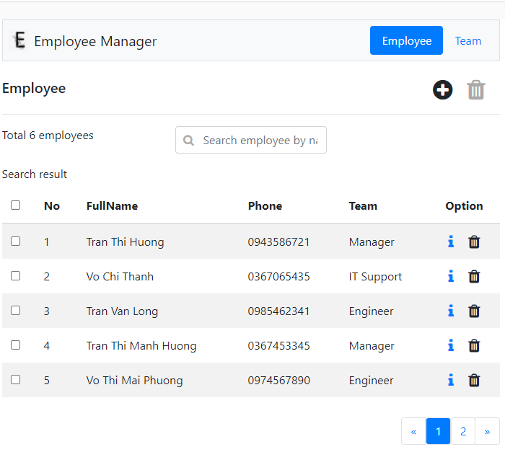
Add and delete employee selected.
Search employe by name.
View detail and delete employee.
Pagination.

Slide 3
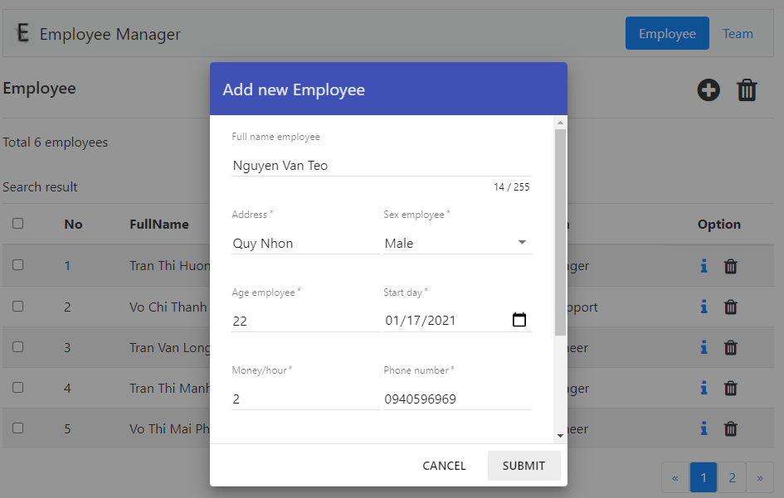
Dialog add new employee.

Slide 4
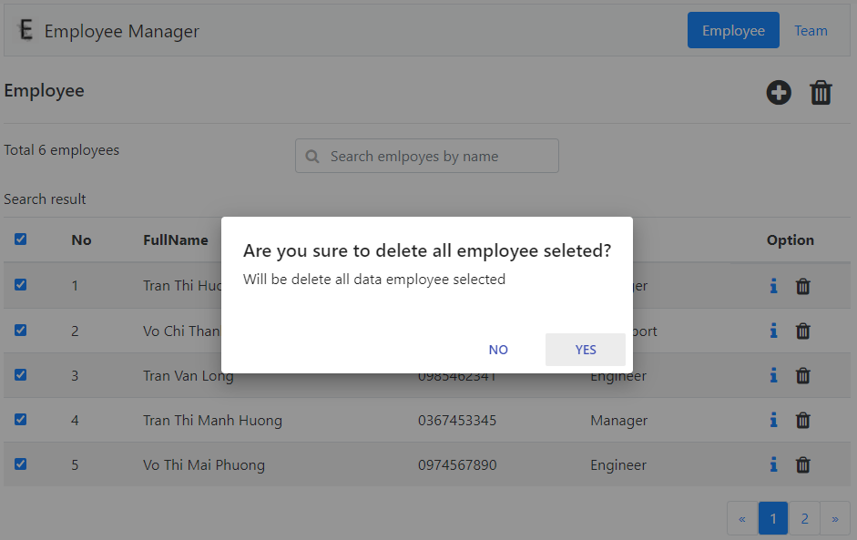
Dialog alert when delete list employee selected.

Slide 5
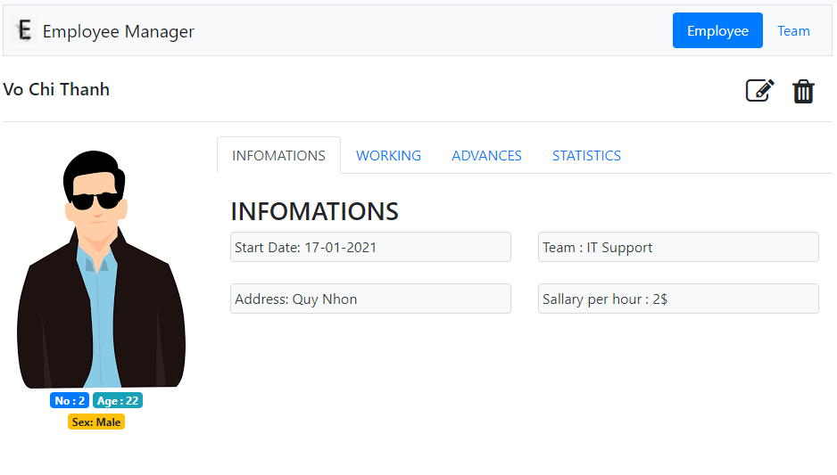
Edit & Delete.

Slide 6
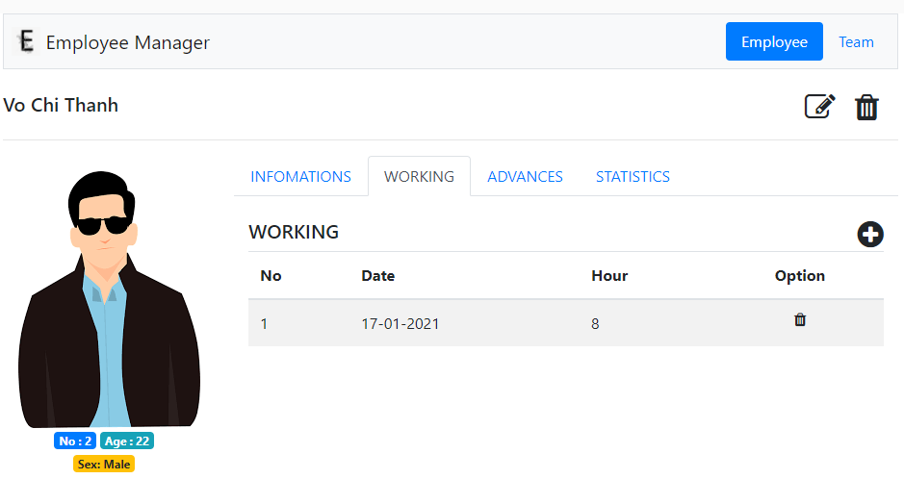
Add new
day working.
List all day working.

Slide 7
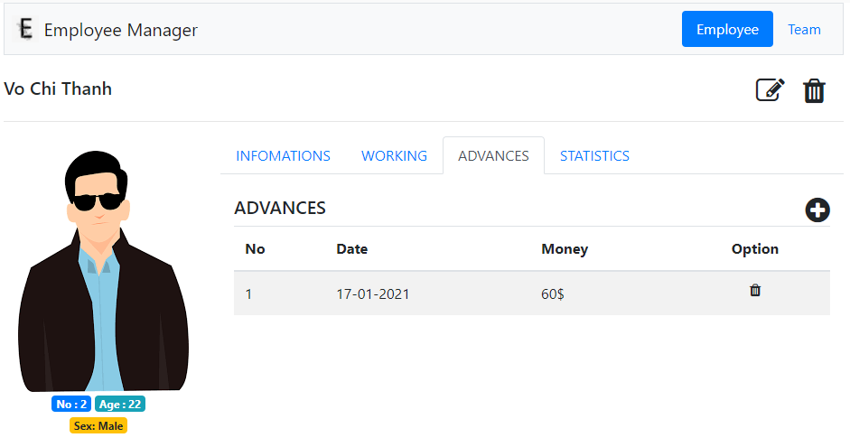
List advance can be add new and delete.

Slide 8
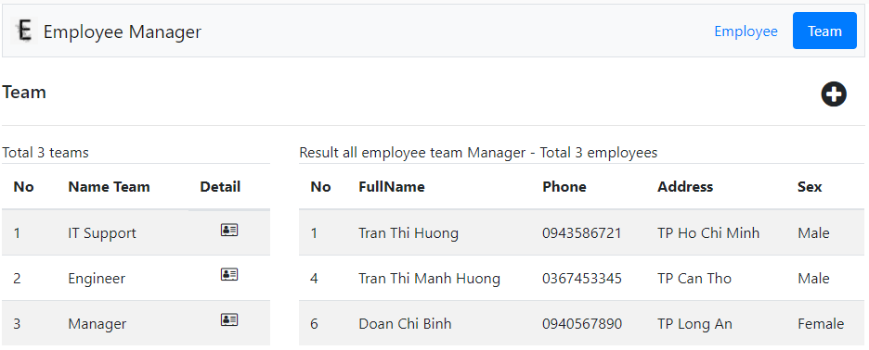
Add new team.
List team and list employee when click on icon detail.

